Slide 1
Text Categorization
Hongning Wang
CS@UVa

Slide 2
Today’s lecture

Slide 3

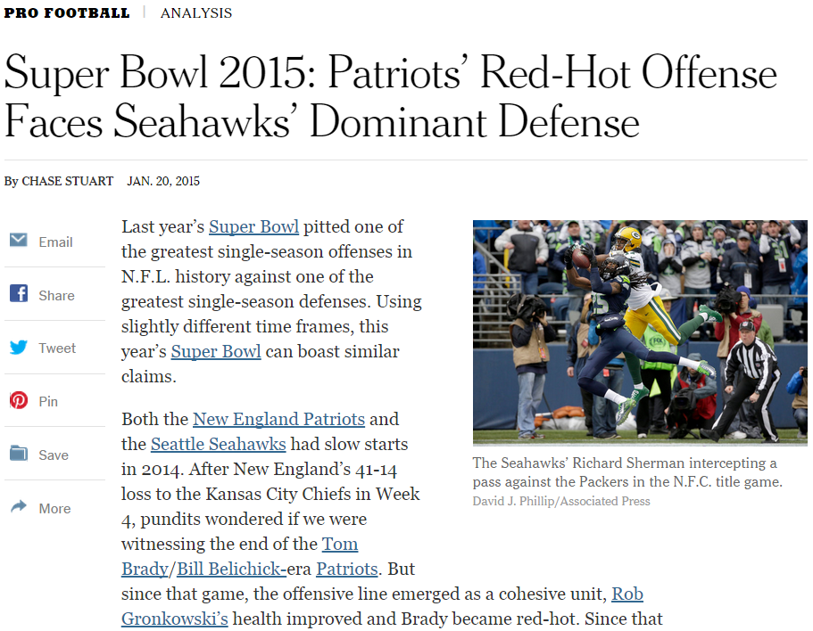
Applications of text categorization
Automatically classify politic news from sports news

Slide 4
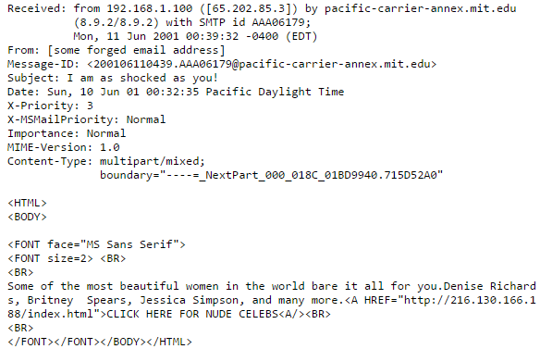
Applications of text categorization
Recognizing spam emails

Slide 5

Applications of text categorization
Sentiment analysis

Slide 6
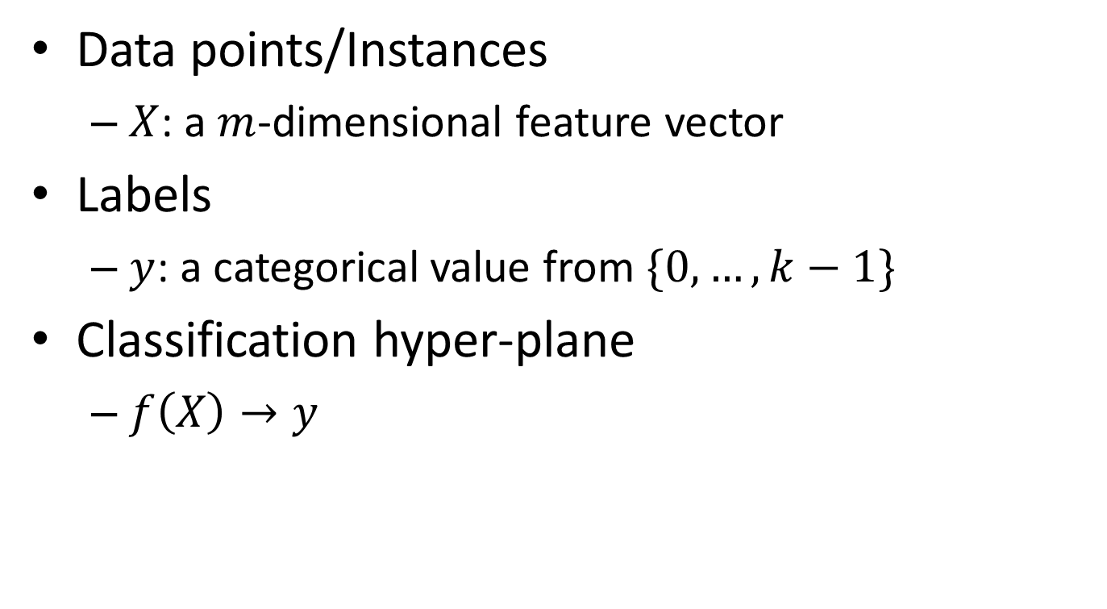
Basic notions about categorization
Data points/Instances
$X$: a $m$-dimensional feature vector
Labels
$y$: a categorical value from $\{0,…,k−1\}$
Classification hyper-plane
$f\left(X\right)→y$

Slide 7
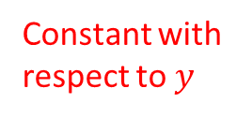
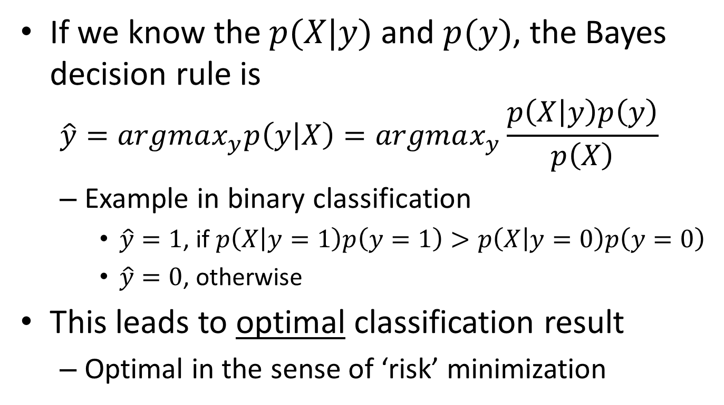
Bayes decision theory
If we know the $p(X|y)$ and $p(y)$, the Bayes decision rule is
$$\hat{y}=argmax_{y}p\left(y | X\right)=argmax_{y}\frac{p\left(X | y\right)p\left(y\right)}{p\left(X\right)}$$
Example in binary classification
$\hat{y}=1$, if $p\left(X | y=1\right)p\left(y=1\right)>p\left(X | y=0\right)p\left(y=0\right)$
$\hat{y}=0$, otherwise
This leads to optimal classification result
Optimal in the sense of ‘risk’ minimization
Constant with respect to $y$

Slide 8
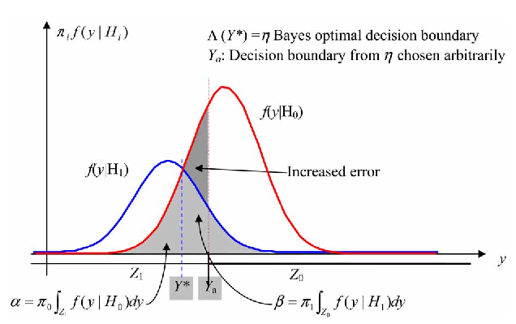

Bayes risk
Risk – assign instance to a wrong class
Type I error: $(y^{∗}=1, \hat{y}=0)$
$p\left(X | y=1\right)p(y=1)$
Type II error: $(y^{∗}=0, \hat{y}=1)$
$p\left(X | y=0\right)p(y=0)$
Risk by Bayes decision rule
$r(X)=min⁡\{p\left(X | y=1\right)p\left(y=1\right), p\left(X | y=0\right)p(y=0)\}$
It can determine a ‘reject region’

Slide 9
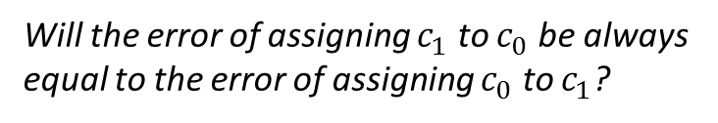




Bayes risk
Expected risk
$E\left[r\left(x\right)\right]=\int_{x}{p\left(x\right)r\left(x\right)dx}$
$$=\int_{x}{p\left(x\right)min⁡\{p\left(X | y=1\right)p\left(y=1\right), p\left(X | y=0\right)p(y=0)\}\text{dx} }$$
$$=p\left(y=1\right)\int_{R_{0}}{p\left(x\right)dx}+p\left(y=0\right)\int_{R_{1}}{p\left(x\right)dx}$$
Region where we assign $x$ to class 0
Region where we assign $x$ to class 1
Will the error of assigning $c_{1}$ to $c_{0}$ be always equal to the error of assigning $c_{0}$ to $c_{1}$?

Slide 10
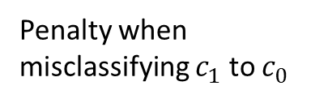
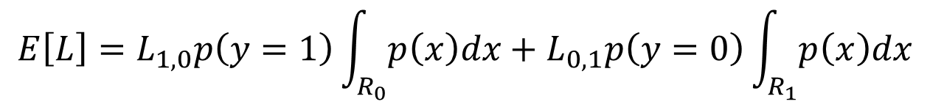
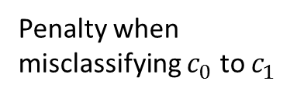
Loss function
The penalty we will pay when misclassifying instances
Goal of classification in general
Minimize loss
$$E\left[L\right]=L_{1,0}p\left(y=1\right)\int_{R_{0}}{p\left(x\right)dx}+L_{0,1}p\left(y=0\right)\int_{R_{1}}{p\left(x\right)dx}$$
Penalty when misclassifying $c_{1}$ to $c_{0}$
Penalty when misclassifying $c_{0}$ to $c_{1}$

Slide 11
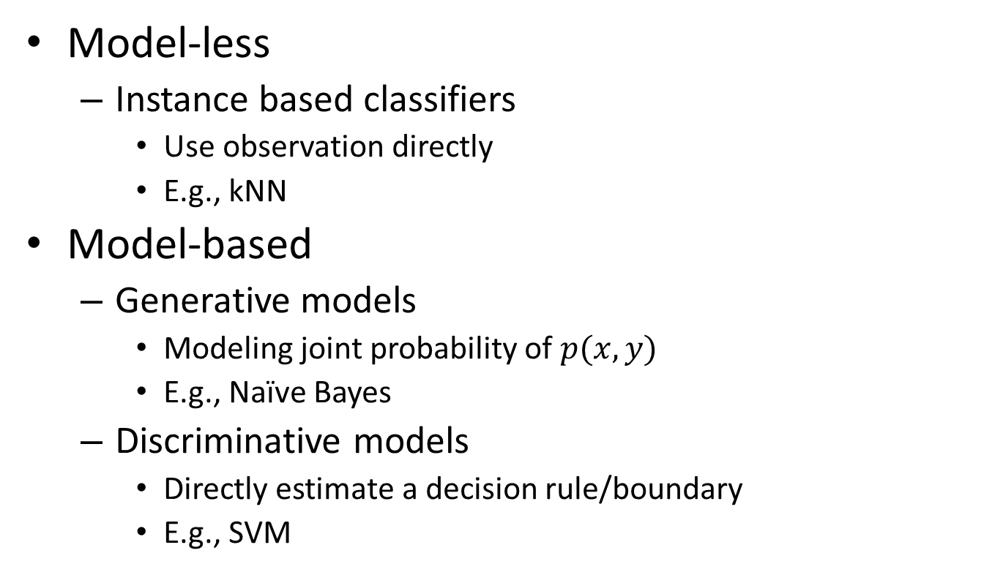
Type of classification methods
Model-less
Instance based classifiers
Use observation directly
E.g., kNN
Model-based
Generative models
Modeling joint probability of $p(x,y)$
E.g., Naïve Bayes
Discriminative models
Directly estimate a decision rule/boundary
E.g., SVM

Slide 12
Supervised text categorization

Slide 13
General steps for text categorization
Feature construction and selection
Model specification
Model estimation and selection
Evaluation
Political News
Sports News
Entertainment News

Slide 14

General steps for text categorization
Feature construction and selection
Model specification
Model estimation and selection
Evaluation
Political News
Sports News
Entertainment News
Consider:
1.1 How to represent the text document?
1.2 Do we need all those features?

Slide 15
General steps for text categorization
Feature construction and selection
Model specification
Model estimation and selection
Evaluation
Political News
Sports News
Entertainment News
Consider:
2.1 What is the unique property of this problem?
2.2 What type of classifier we should use?

Slide 16
General steps for text categorization
Feature construction and selection
Model specification
Model estimation and selection
Evaluation
Political News
Sports News
Entertainment News
Consider:
3.1 How to estimate the parameters in the selected model?
3.2 How to control the complexity of the estimated model?

Slide 17
General steps for text categorization
Feature construction and selection
Model specification
Model estimation and selection
Evaluation
Political News
Sports News
Entertainment News
Consider:
4.1 How to judge the quality of learned model?
4.2 How can you further improve the performance?

